Slide 1
Indian cuisine preparation time analysis
PRESENTED BY:
SHUBHAM UPADHYAY
PROJECT FILE:
INDIAN CUISINE PREPARATION TIME ANALYSIS

Slide 2
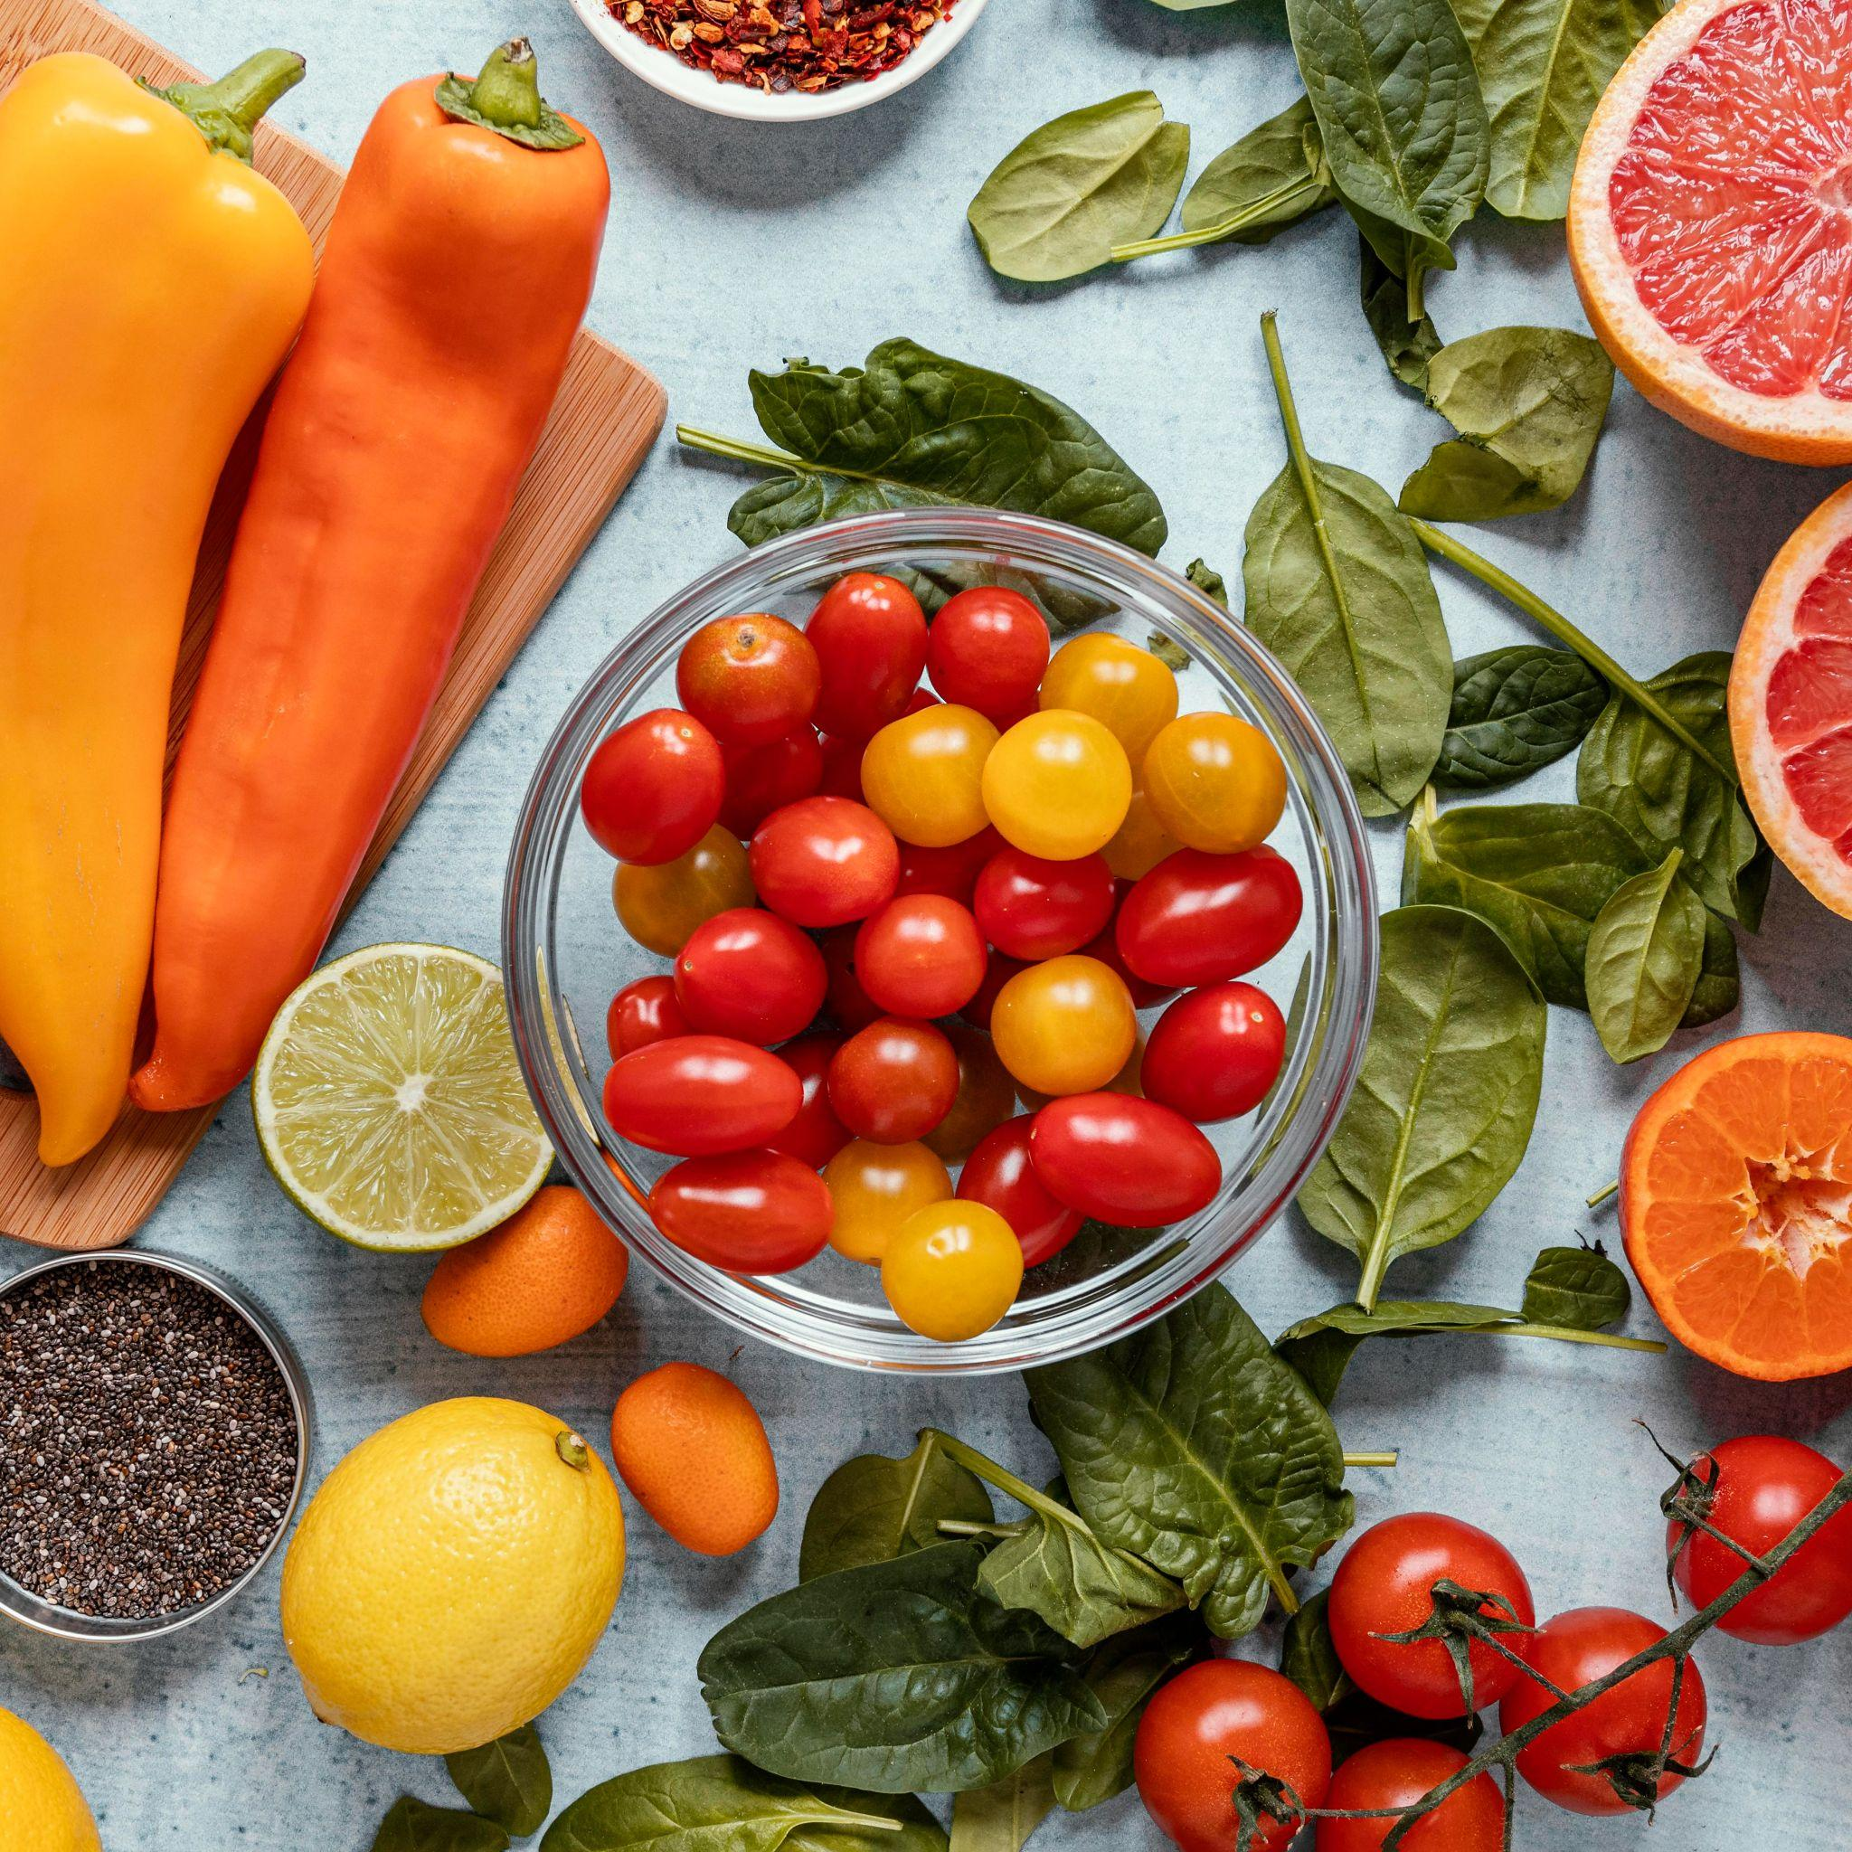
Introduction
This dataset explores the preparation and cooking times of various Indian dishes, along with their typical serving sizes. It provides insights into the time and effort involved in creating diverse Indian culinary delights. By analyzing this data, we can uncover patterns and relationships between dish types, preparation methods, cooking durations, and serving quantities. This information can be valuable for understanding the complexity and diversity of Indian cuisine, as well as for meal planning and culinary exploration. The dataset includes information on a variety of popular Indian dishes, offering a glimpse into the rich culinary traditions of India.

Slide 3
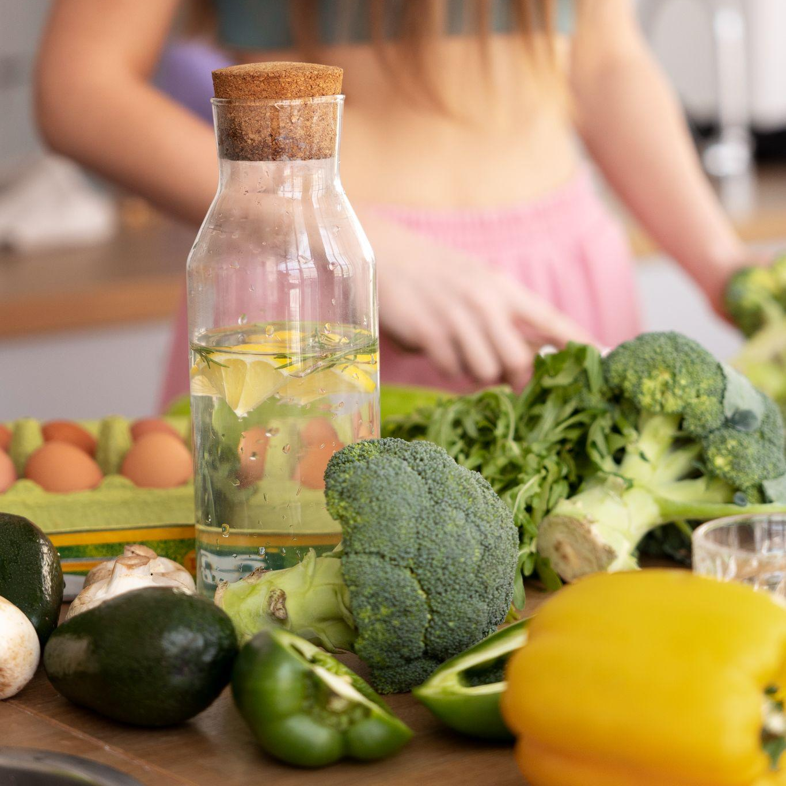
0bjective
Download the CSV file from the website and upload it to Google Colab. Begin the data cleaning process by removing any unnecessary columns in the file. Next, identify any null values and address them appropriately. Check for outliers in the data set. Finally, analyse the dataset to extract key findings and create visual charts to represent your analysis.

Slide 4
Key Question
1. | What is the distribution of cooking times for each Indian dish?
2. | How does the preparation time vary across different Indian dishes?
3. | What is the typical serving size for each Indian dish?
4. | How does the cooking time of dishes change over the dataset?
5. | How does the preparation time of dishes change over the dataset?
6. | How does the serving size of dishes change over the dataset?
7. | Is there a correlation between preparation time and cooking time for Indian dishes?
8. | Is there a relationship between serving size and preparation time for Indian dishes?
9. | Which Indian dishes are most frequently represented in the dataset?

Slide 5
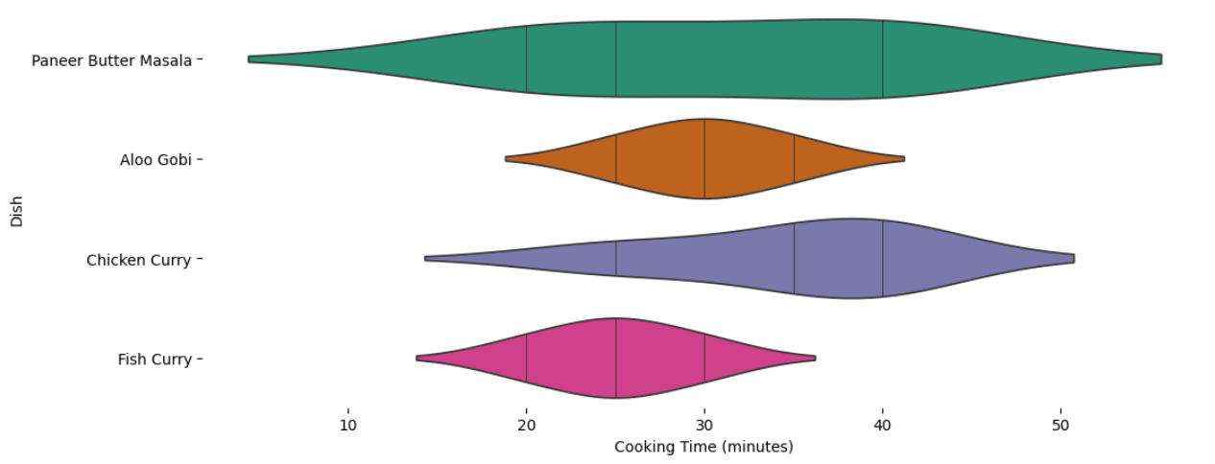
Indian Dish Cooking Time Distribution
This violin plot, a graphical representation of the distribution of cooking times for different Indian dishes. Each violin shape represents a dish, and the width of the violin at a particular cooking time indicates the density of observations at that time. The vertical lines within each violin shape likely represent quartiles or other percentiles of the cooking time distribution.
From the plot, we can observe that Paneer Butter Masala and Chicken Curry tend to have longer cooking times, with their distributions extending further to the right. Aloo Gobi and Fish Curry, on the other hand, appear to have shorter cooking times, with their distributions concentrated more towards the left. The violin shapes also provide insights into the spread of cooking times for each dish. For instance, Paneer Butter Masala seems to have a wider range of cooking times compared to Fish Curry, suggesting more variability in its preparation time.

Slide 6
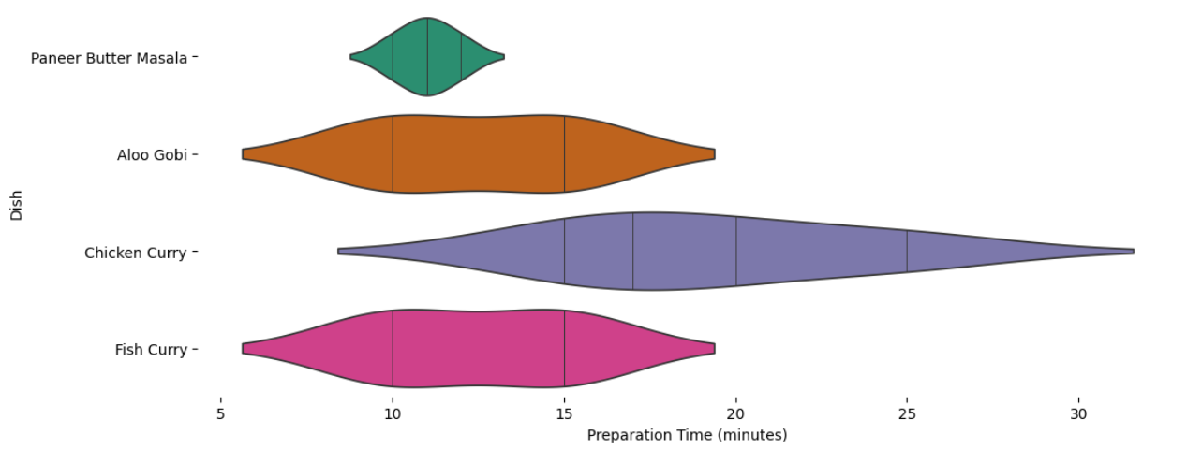
Preparation Time Variation in Indian Dishes
This violin plot, a visualization technique that displays the distribution of cooking times for four different Indian dishes: Paneer Butter Masala, Aloo Gobi, Chicken Curry, and Fish Curry. Each violin shape represents a dish, and its width at a specific cooking time reflects the density of observations at that time. The vertical lines within each violin indicate quartiles or other percentiles of the cooking time distribution.
From the plot, we can observe that Paneer Butter Masala and Chicken Curry generally have longer cooking times, with their distributions extending further to the right. In contrast, Aloo Gobi and Fish Curry tend to have shorter cooking times, with their distributions concentrated more towards the left. The violin shapes also provide insights into the spread of cooking times for each dish. For example, Paneer Butter Masala appears to have a broader range of cooking times compared to Fish Curry, suggesting greater variability in its preparation time.

Slide 7
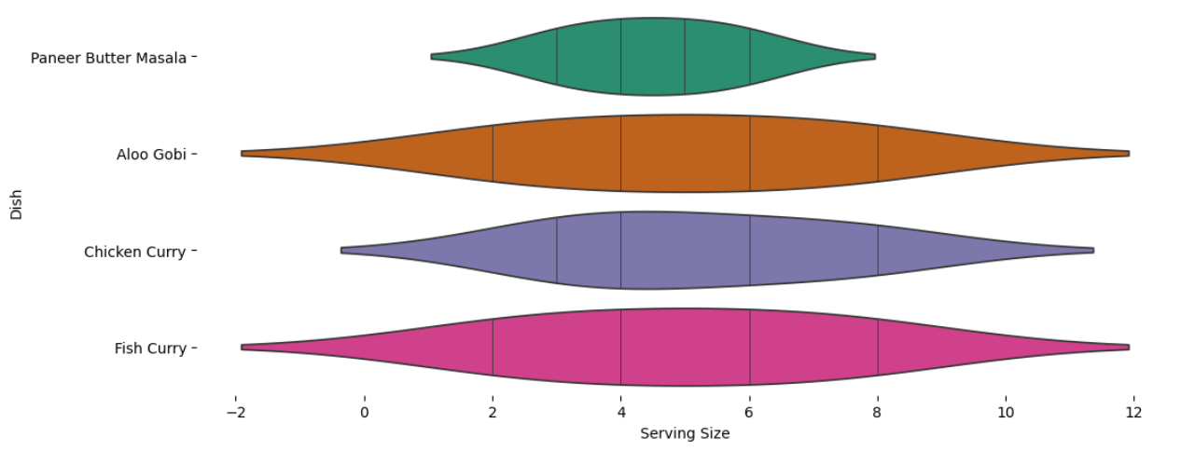
Typical Serving Sizes for Indian Dishes
This violin plot, a graphical representation of the distribution of serving sizes for different Indian dishes: Paneer Butter Masala, Aloo Gobi, Chicken Curry, and Fish Curry. Each violin shape represents a dish, and the width of the violin at a specific serving size indicates the density of observations at that size. The vertical lines within each violin shape likely represent quartiles or other percentiles of the serving size distribution.
From the plot, we can observe that Paneer Butter Masala and Chicken Curry tend to have larger serving sizes, with their distributions extending further to the right. Aloo Gobi and Fish Curry, on the other hand, appear to have smaller serving sizes, with their distributions concentrated more towards the left. The violin shapes also provide insights into the spread of serving sizes for each dish. For instance, Paneer Butter Masala seems to have a wider range of serving sizes compared to Fish Curry, suggesting more variability in its portion sizes.

Slide 8
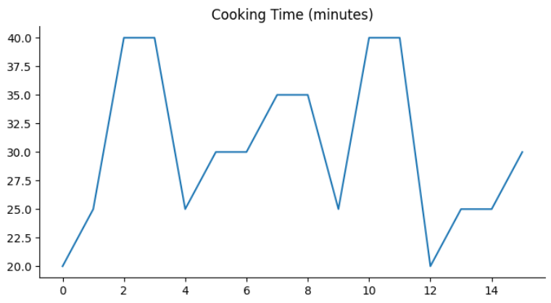
Cooking Time Trends
This line graph illustrating the cooking time (in minutes) over a certain period. The x-axis likely represents time intervals, while the y-axis represents the corresponding cooking times. The line shows fluctuations in cooking time over the observed period.
The graph shows that the cooking time initially starts at a low value and then rapidly increases to a peak around the 2nd time interval. It then decreases sharply before increasing again to another peak around the 10th time interval. Following this, the cooking time decreases significantly and remains relatively stable for a few time intervals before increasing again towards the end of the observed period.

Slide 9
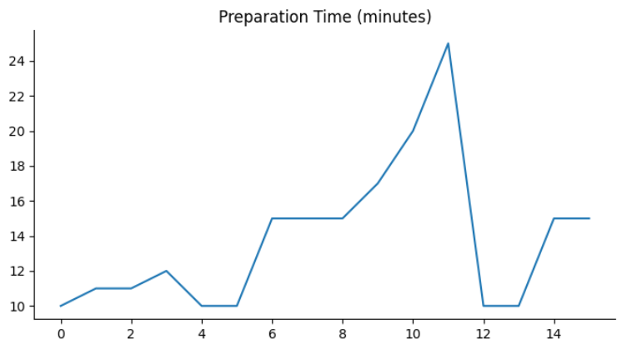
Prep Time Trends
This line graph illustrating the preparation time (in minutes) over a certain period. The x-axis likely represents time intervals, while the y-axis represents the corresponding preparation times. The line shows fluctuations in preparation time over the observed period.
The graph shows that the preparation time initially starts at a low value and then gradually increases to a peak around the 11th time interval. It then decreases sharply before increasing again towards the end of the observed period. Following this, the preparation time remains relatively stable for a few time intervals.

Slide 10
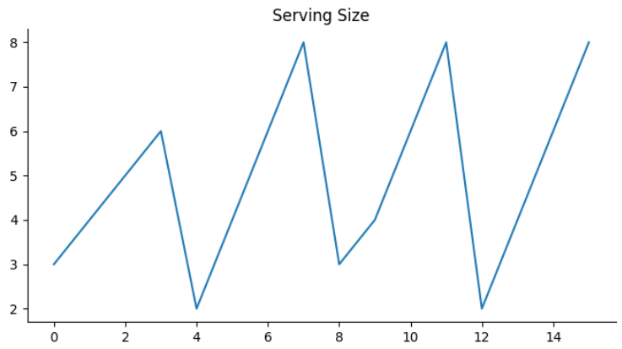
Serving Size Trends
This line graph illustrating the serving size over a certain period. The x-axis likely represents time intervals, while the y-axis represents the corresponding serving sizes. The line shows fluctuations in serving size over the observed period.
The graph shows that the serving size initially starts at a low value and then gradually increases to a peak around the 7th time interval. It then decreases sharply before increasing again towards the end of the observed period. Following this, the serving size remains relatively stable for a few time intervals.

Slide 11
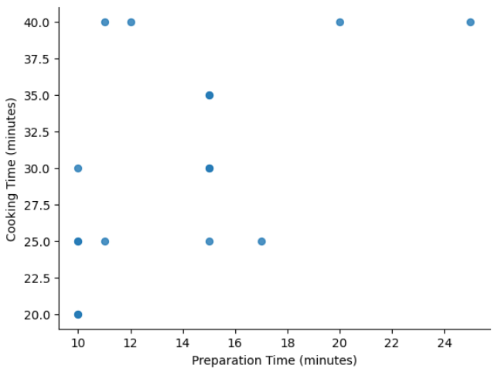
Correlation Between Prep and Cooking Time
This scatter plot explores the relationship between cooking time and preparation time. Each point on the plot represents a data point with values for both cooking time and preparation time. The x-axis represents the preparation time in minutes, while the y-axis represents the cooking time in minutes.
From the scatter plot, we can observe that there is a general trend of increasing cooking time with increasing preparation time. However, the relationship is not perfectly linear, and there is some variability in the data. Some points deviate from the overall trend, suggesting that other factors besides preparation time may also influence cooking time.

Slide 12
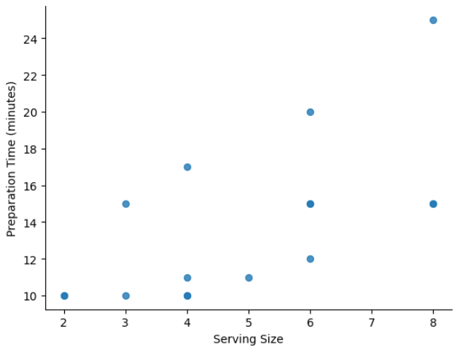
Serving Size and Prep Time Relationship
This scatter plot explores the relationship between preparation time and serving size. Each point on the plot represents a data point with values for both preparation time and serving size. The x-axis represents the serving size, while the y-axis represents the preparation time in minutes.
From the scatter plot, we can observe that there is a general trend of increasing preparation time with increasing serving size. However, the relationship is not perfectly linear, and there is some variability in the data. Some points deviate from the overall trend, suggesting that other factors besides serving size may also influence preparation time.

Slide 13
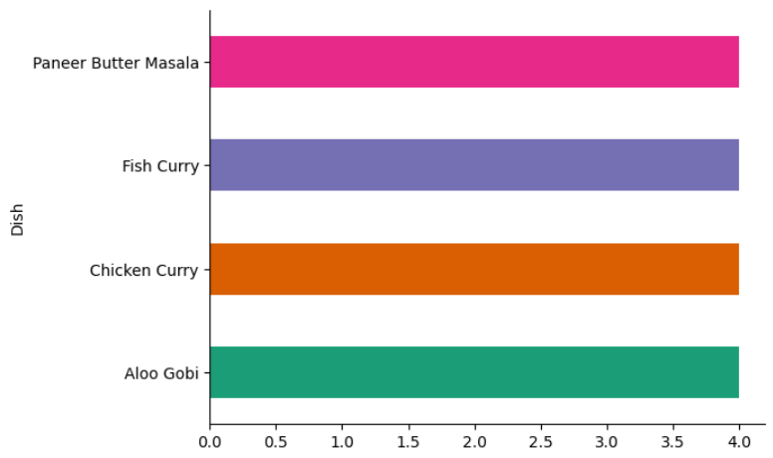
Most Common Indian Dishes in Datasets
This bar chart compares the popularity of different Indian dishes. The y-axis represents the dish names, while the x-axis likely represents a measure of popularity, such as the number of orders or ratings. The length of each bar corresponds to the popularity level of the dish.
From the chart, we can observe that Paneer Butter Masala seems to be the most popular dish, followed by Fish Curry and Chicken Curry. Aloo Gobi appears to be the least popular dish among the four. The bar chart provides a clear visual comparison of the popularity levels of these Indian dishes.

Slide 14
Conclusion
This analysis reveals the diversity of Indian cuisine in terms of cooking and preparation times, and serving sizes. Dishes vary significantly in their time requirements, with a moderate correlation between preparation and cooking times. Serving sizes remain relatively consistent. Certain dishes are more prevalent in the dataset, highlighting their popularity. This information offers valuable insights for culinary exploration and meal planning, while further analysis can explore deeper trends within Indian cuisine.

Slide 15
Thankyou so much

